Slide 1

AURORA’S SCIENTIFIC AND TECHNOLOGICAL INSTITUTE, GHATKESAR-501301
Approved by AICTE, affiliated to JNTUH Hyderabad,
Telangana [2024-2025]
DEPARTMENT OF COMPUTER SCIENCE AND ENGINEERING
III year - ­II semester
Presented by:
G.MADHURI [23M95A0511]
J.BUDDA DEV` [23M95A0513]
D.SANTHOSH [23M95A0514]
N.VINSAI [23M95A0515]
R.SRIMAN [23M95A0521]
INDUSTRIAL ORIENTED MINI PROJECT
PRESENTATION ON
YouTube Video Downloader

Slide 2
CONTENTS
Introduction Slide - 4
User interface Design Slide - 5
Technologies Used Slide - 6
4. System Workflow Slide -7
5. Code Highlights Slide - 8
6. Key Features Slide -9
Learning Outcomes Slide -10
Code Slide -11
9. Conclusion Slide -12

Slide 3





YouTube Video Downloader – Web Application
A Mini Project using Python Flask and Pytube
This project is a simple yet practical web-based application that allows users to download YouTube videos easily by just entering a video URL. It is built using HTML, CSS, Python, Flask, and Pytube.
FRONTEND
BACKEND

Slide 4
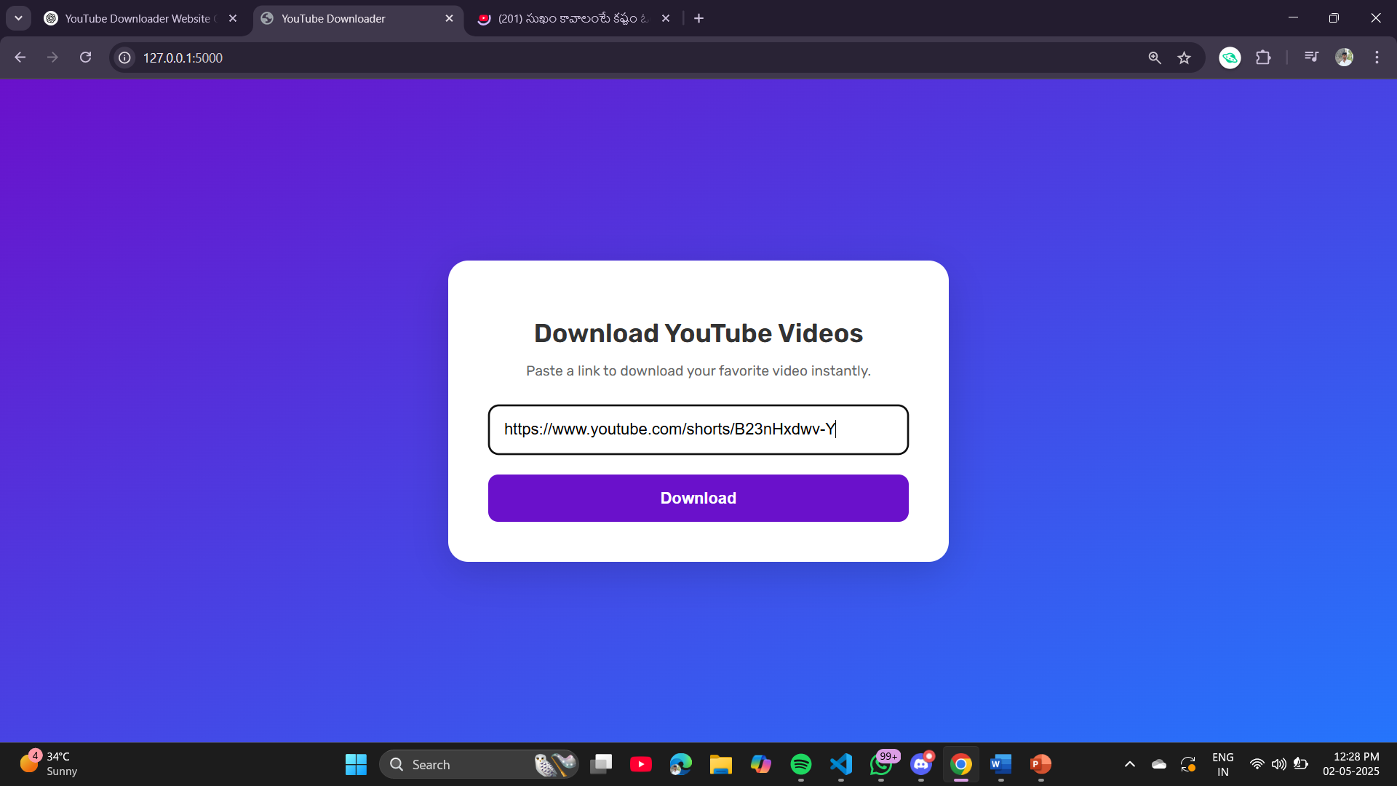
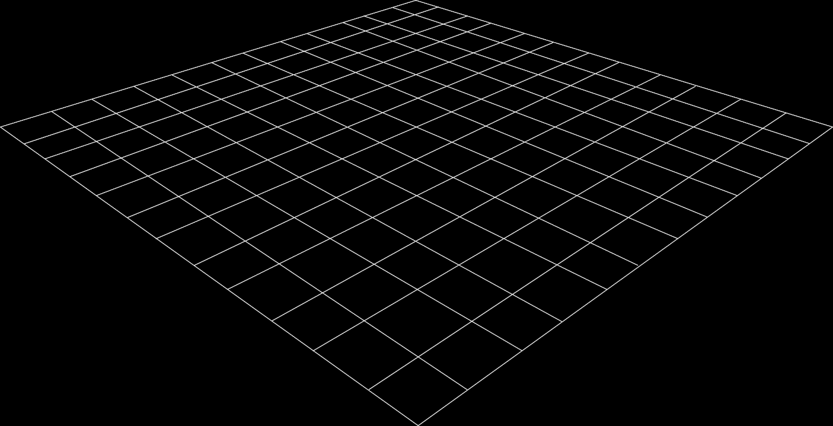
🧠 Introduction : What is the YouTube Video Downloader?
What is this project?
This project is a web application that provides an easy way to download videos from YouTube. The user simply pastes the URL of a video, clicks the download button, and the video gets saved locally. The goal is to demonstrate how frontend and backend technologies work together to build a real-world application.

Slide 5
💻User Interface Design : Simple and Clean UI
Explanation: The interface is designed to be minimal and user-friendly. The page includes:
An input box to paste the YouTube video URL
A download button
A message area to show success or error The design uses modern CSS for styling and responsiveness.
Displays success/error message

Slide 6
Existing System : Existing Solutions in the Market
There are many websites and applications that allow users to download YouTube videos, such as:
SaveFrom.net
Y2Mate
4K Video Downloader However, most of these services have limitations such as pop-up ads, paid subscriptions, or limited video quality. This project aims to provide a cleaner, ad-free, and customizable alternative using open-source tools.

Slide 7
Proposed System : Our Proposed Solution
A completely ad-free user experience
The ability to fetch and download videos in high quality
Simple and responsive web interface
Easy-to-understand source code for learning purposes It is built entirely using open-source technologies and can be hosted or extended easily by students or developers.

Slide 8
System Requirements : Hardware and Software Requirements
Hardware:
Minimum 2GB RAM (4GB Recommended)
At least 500MB Disk Space
Internet Connection
Software:
Python 3.x Installed
Flask Framework
Pytube Library
Code Editor (e.g., VS Code, Sublime Text)
Web Browser (Chrome, Firefox, etc.)

Slide 9
🧱Technologies Used : Tools and Technologies
Frontend : HTML & CSS: For designing the webpage and layout
Backend : Python Flask: For handling backend routes and logic
Library : Pytube: A Python library that allows downloading videos from YouTube These technologies combine to create a seamless user experience.

Slide 10
⚙️ System Workflow Title: How It Works Explanation:
User opens the web page and enters the YouTube video URL
The URL is submitted via a form to the Flask backend
Flask passes the URL to Pytube
Pytube fetches the video and downloads it in the best quality
A message is shown to the user (Success or Error)
Video is downloaded locally

Slide 11
Modules Overview : Step-by-Step Modules
Frontend Module: HTML/CSS interface where the user inputs the YouTube video URL.
Form Handling Module: JavaScript to capture and send the input to Flask backend.
Backend Processing Module: Flask receives the URL and uses Pytube to fetch the video.
Download Module: Pytube downloads the highest resolution video.
Response Module: Success or error message is sent back to the user interface. Each module works
together to create a complete download flow

Slide 12
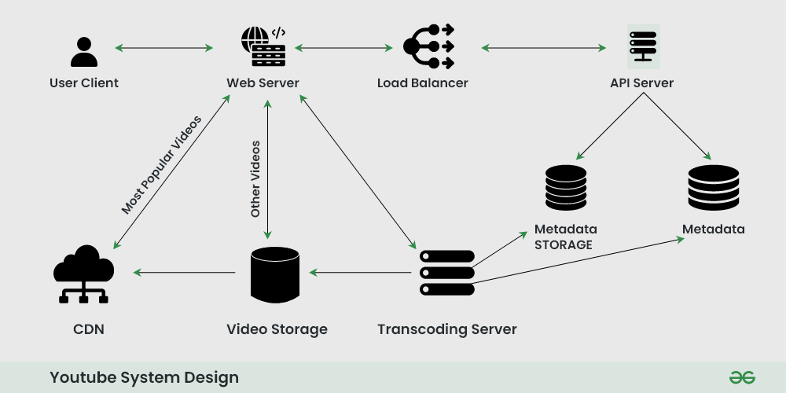
System Architecture :Architecture Diagram
This project follows a client-server architecture:
Client Side (Browser): HTML/CSS/JavaScript UI
Server Side (Flask App): Accepts input and processes the download
YouTube Server: Source from which the video is fetched using Pytube Flow: Client → Flask Server → YouTube (via Pytube) → Flask → Client This ensures clear communication between the user, the server, and the video platform.

Slide 13
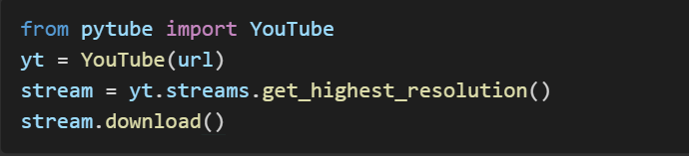
🔧Code Highlights: Backend Code Explanation
The main logic is in app.py
Flask handles the HTTP POST request
Pytube is used to fetch and download the video
Error handling is included to catch invalid URLs
Example Snippet:

Slide 14
✅Key Features : What Makes This Useful?
Simple and easy to use
Downloads highest resolution video
Works with just a browser and Python
Can be extended with more features like audio downloads This makes it a practical mini-project for learning and demonstration.

Slide 15
📚Learning Outcomes : What I Learned
How to build a full-stack web application
How to use Flask for web development
How to integrate third-party libraries like Pytube
Basic error handling and user feedback mechanisms These skills are essential for building real-world projects.

Slide 16
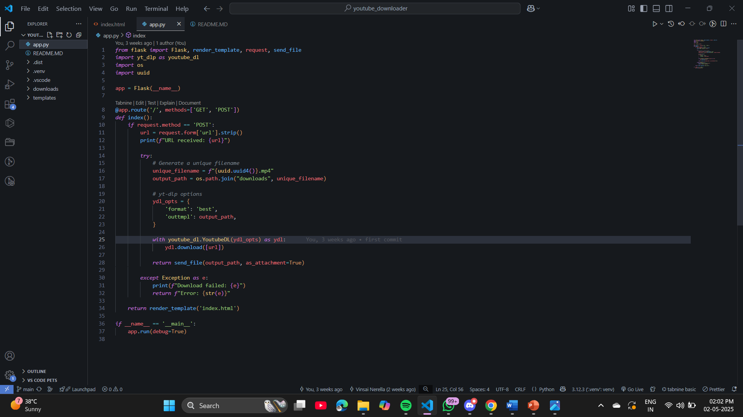
PROGRAM CODE

Slide 17
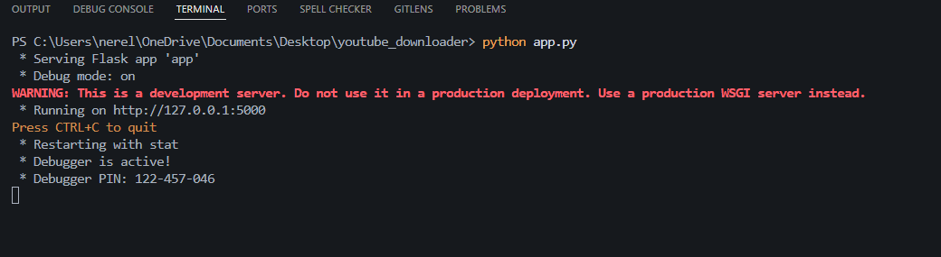
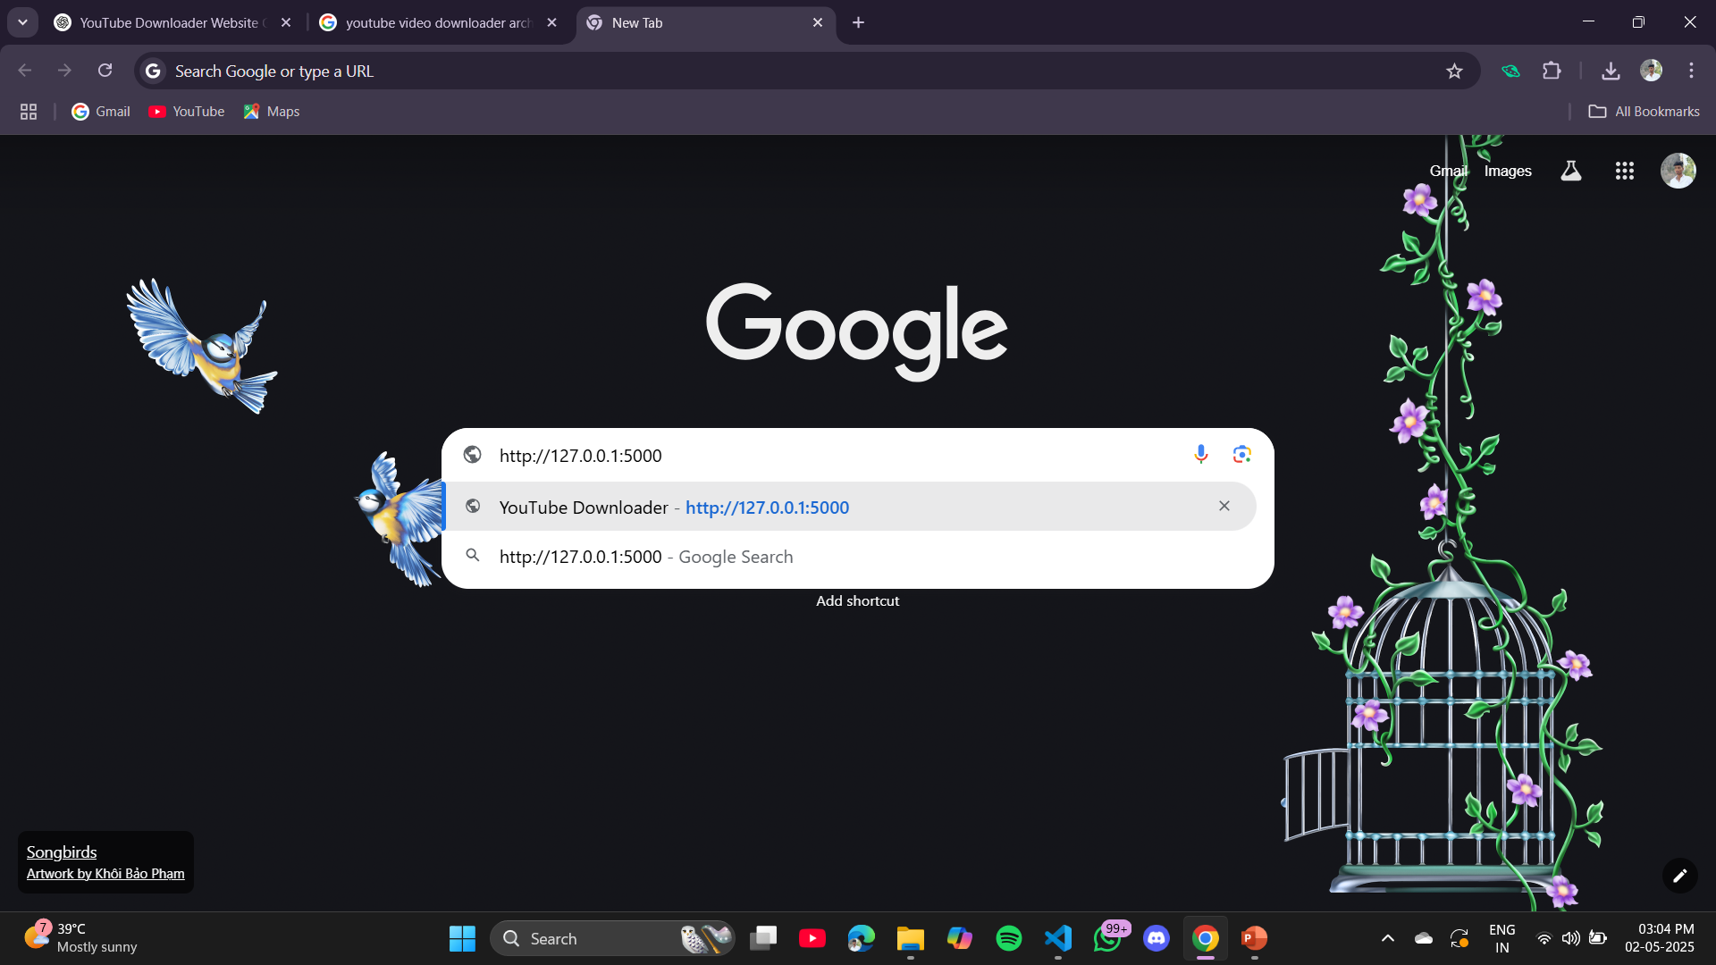
Results

Slide 18
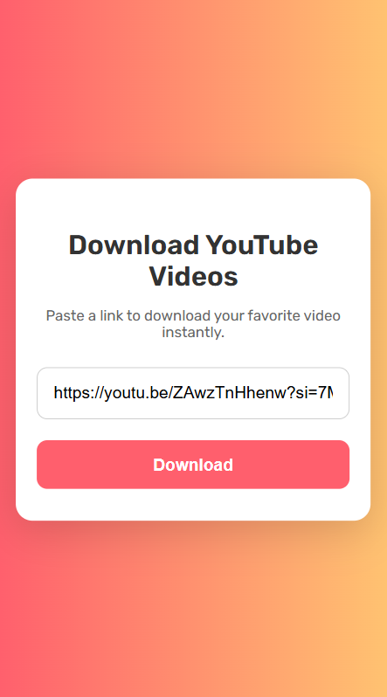
Mobile View
Desktop View

Slide 19
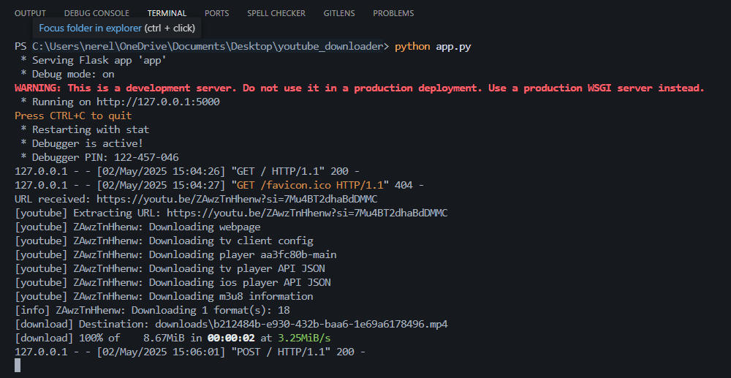
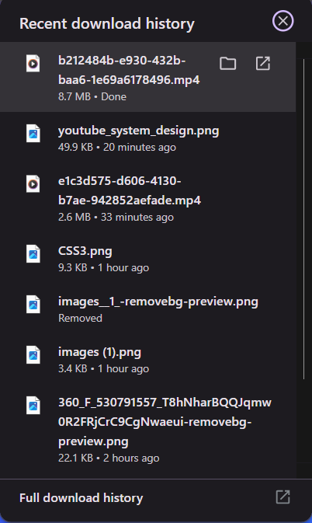
Backend
User Browser downloads

Slide 20
🚀Conclusion & Future Scope : Wrapping Up
This YouTube downloader is a functional project that demonstrates full-cycle development.
It shows how backend logic and frontend design work together. Future Enhancements:
Choose video quality (360p, 720p, 1080p)
Download audio (MP3)
Add progress bar and file size info
Host online for public use

Slide 21
Future Scope: Future Enhancements
Add video quality selection (360p, 720p, 1080p)
Download only audio (MP3 format)
Add file size info and progress bar
User account system with download history
Deploy the application online for public use These improvements can make the project even more powerful and user-friendly.

Slide 22
A PROJECT PRESENTED BY BATCH - 12 :
G.MADHURI [23M95A0511]
J.BUDDA DEV [23M95A0513]
D.SANTHOSH [23M95A0514]
N.VINSAI [23M95A0515]
R.SRIMAN [23M95A0521]

